Slide 1
5 selfish reasons to work reproducibly
More publications, more grants, more awesome!

Slide 2
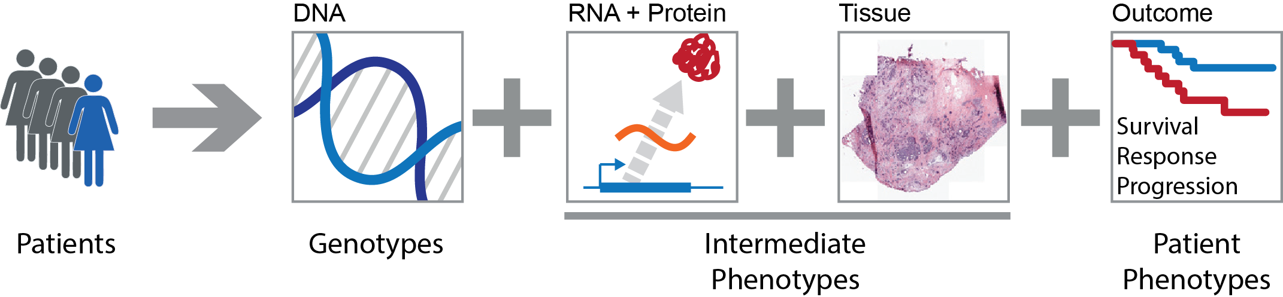
Systems Genetics of Cancer
Genetic variation
In people
In tumours
In clones
Phenotypic variation
Tumour subtypes
Aggressiveness
Survival

Slide 3
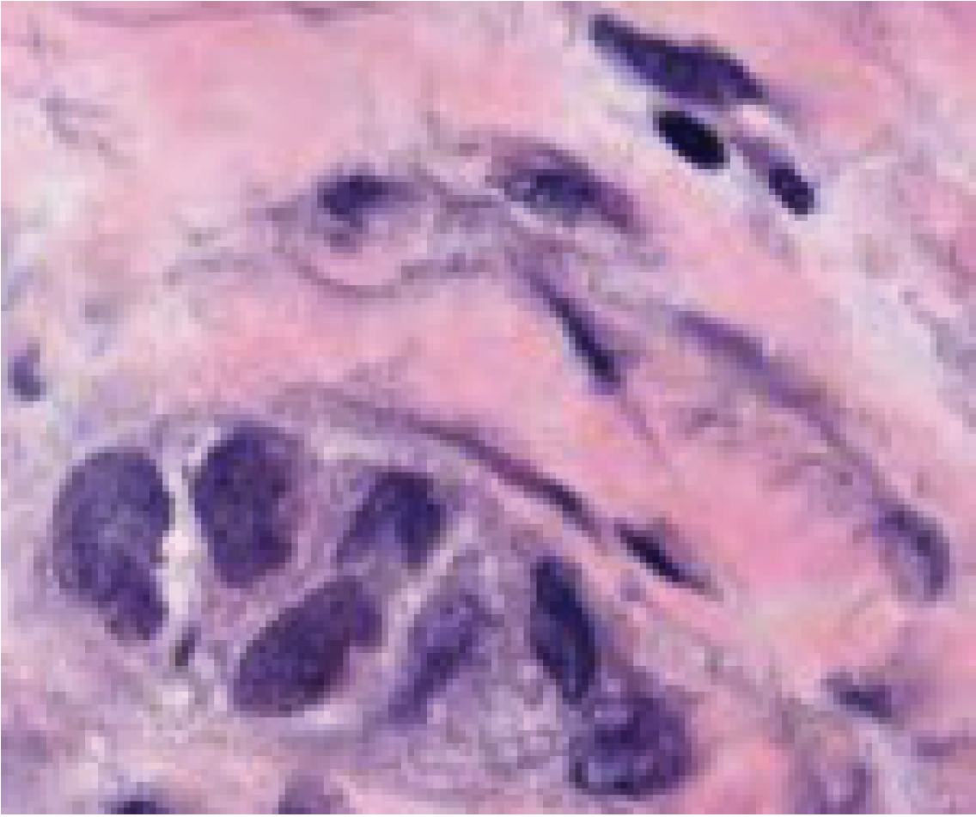


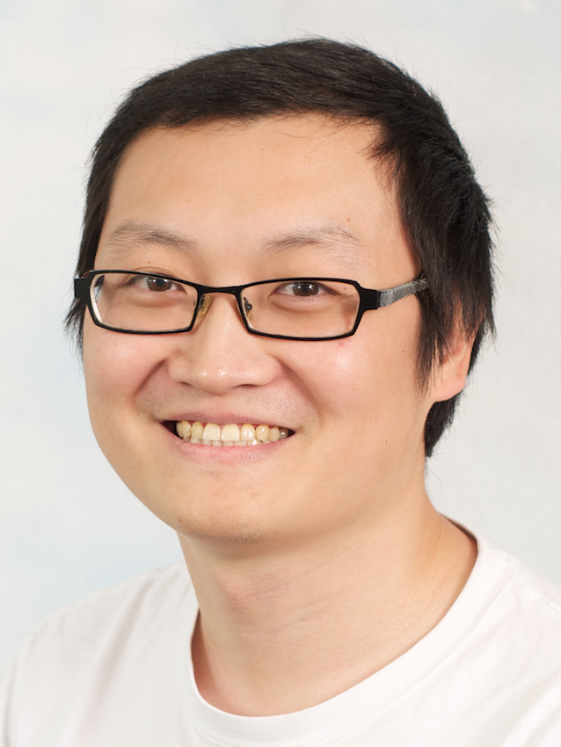
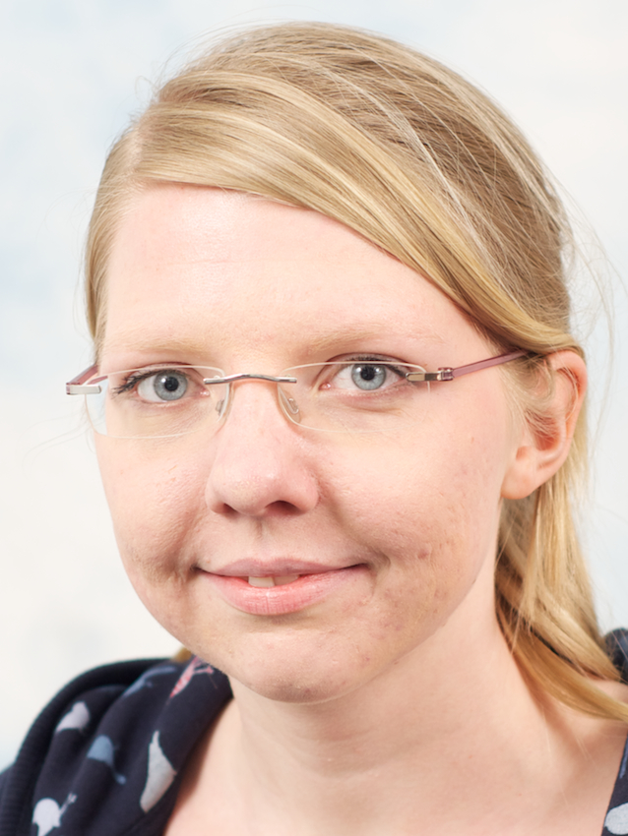
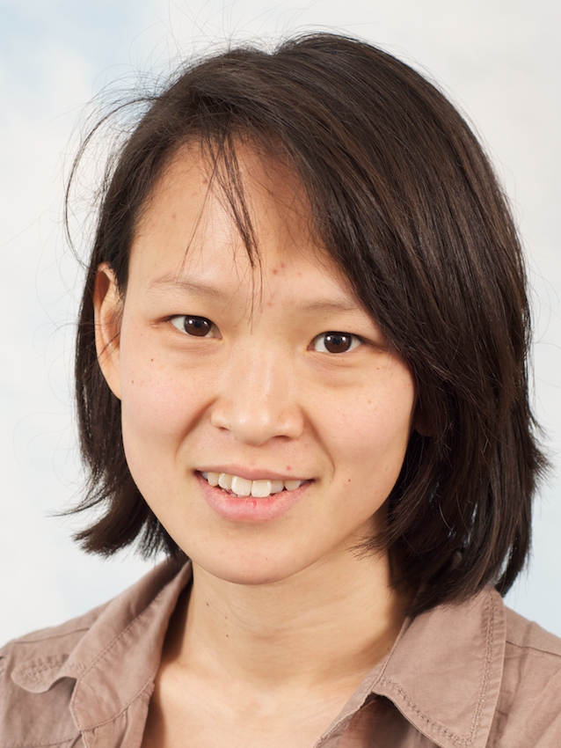

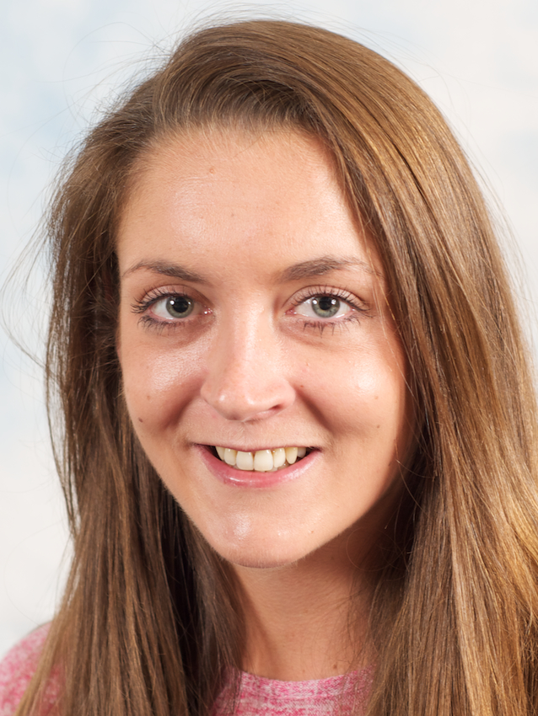



Cancer genome
Function
Cancer genome
Evolution
Cancer tissue
Context
Andy
Wei
Ke
Edith
Anne
Joe
Amanda
Ines
Geoff
Leon

Slide 4
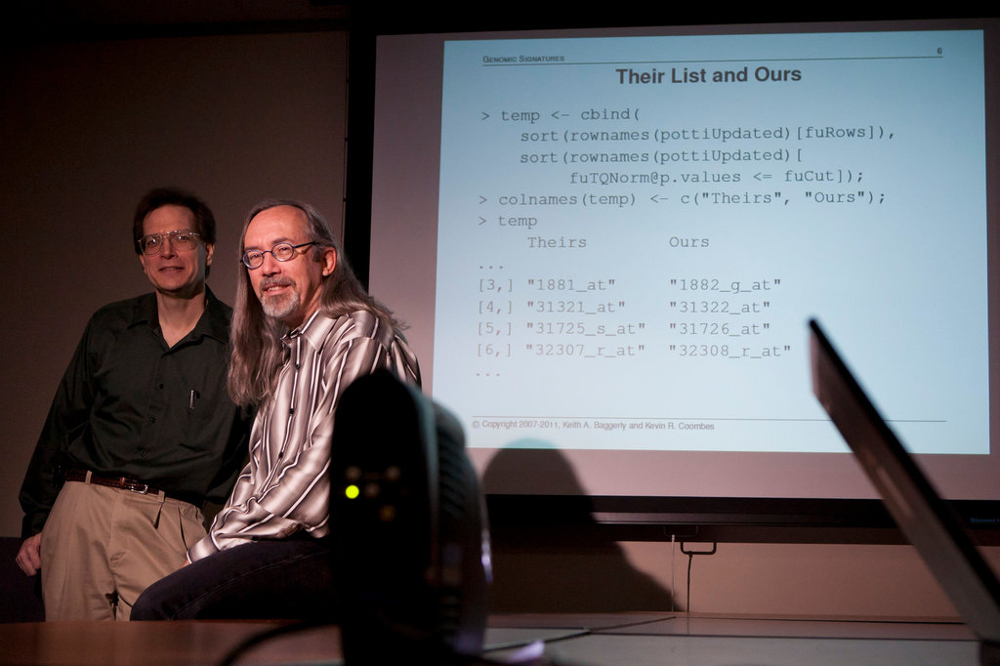
“How Bright Promise in Cancer Testing Fell Apart” New York Times, July 7, 2011

Slide 5
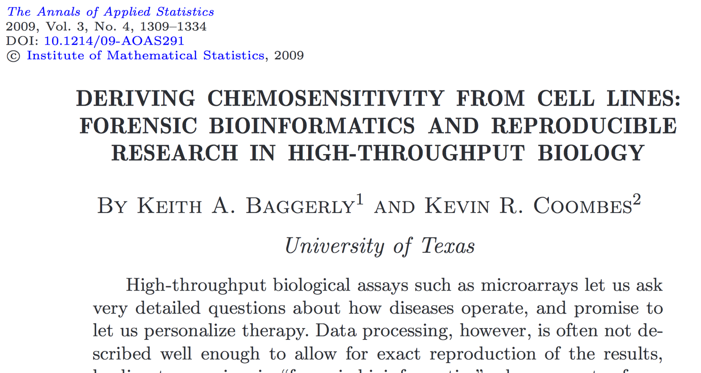

Slide 6
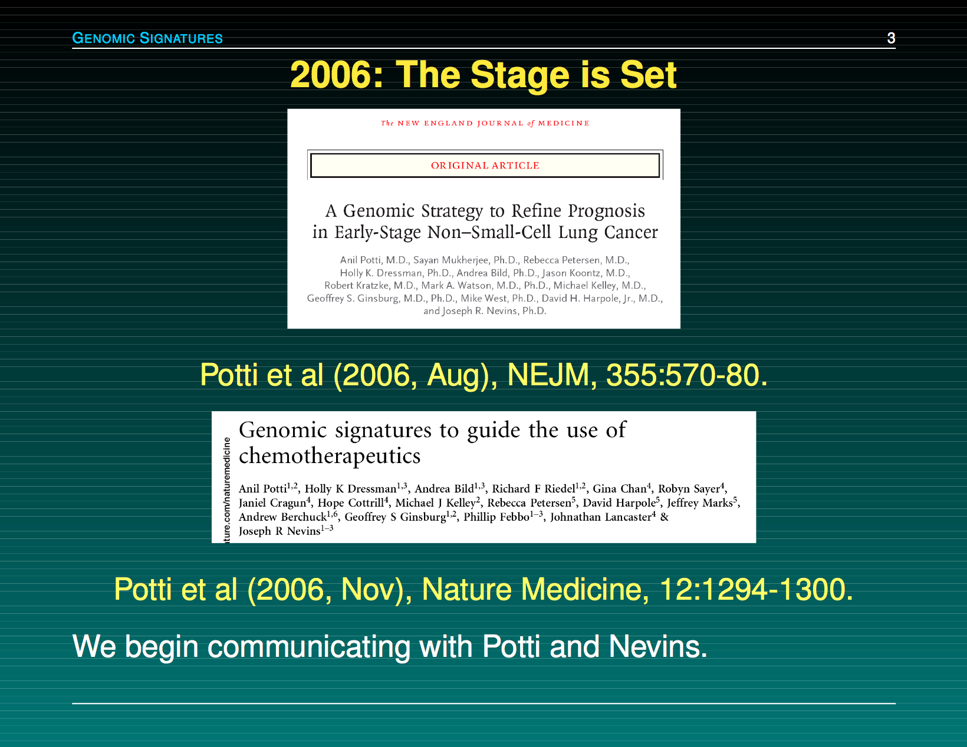

Slide 7
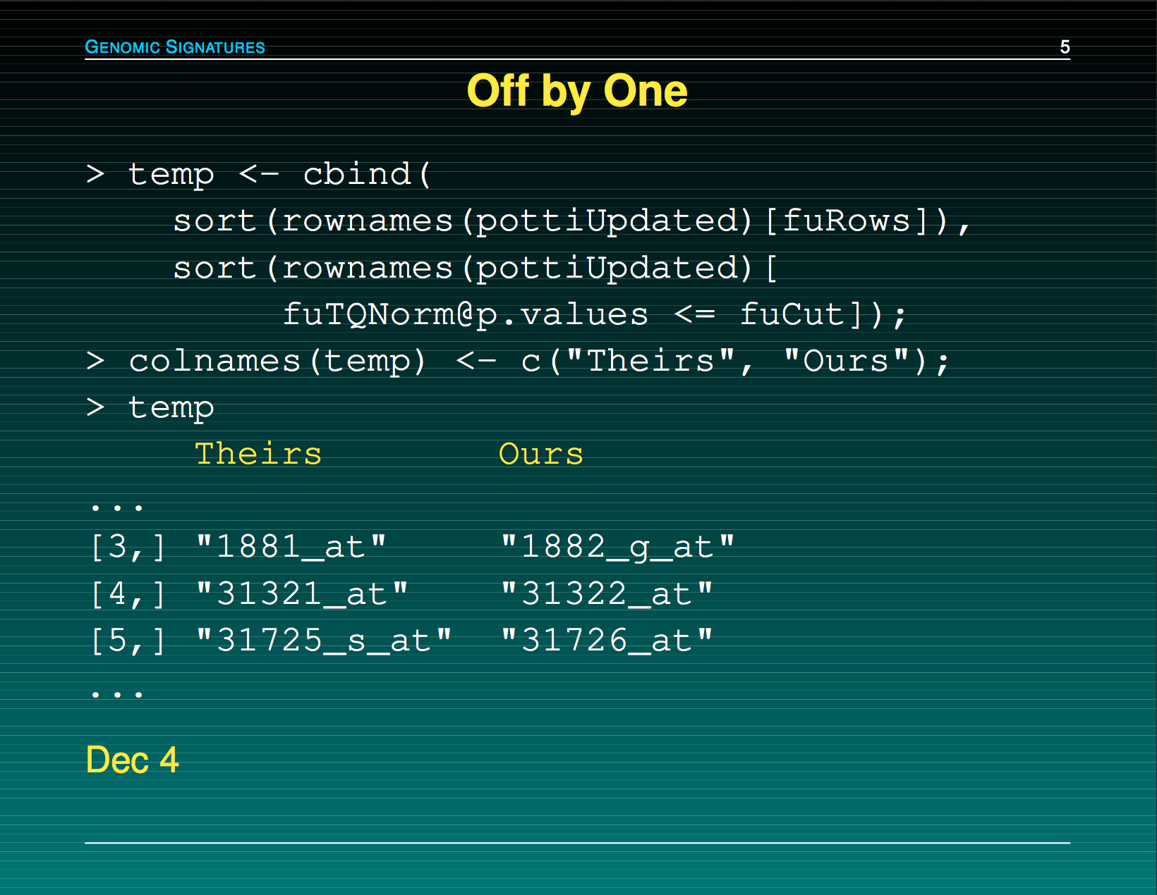
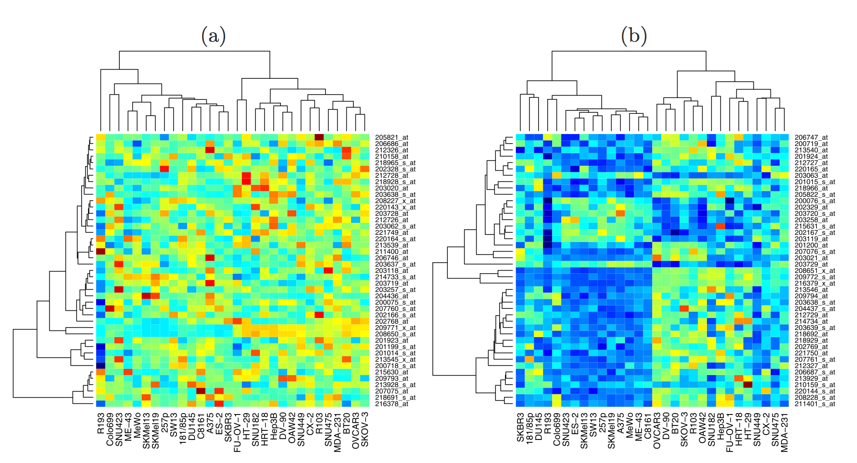

Slide 8
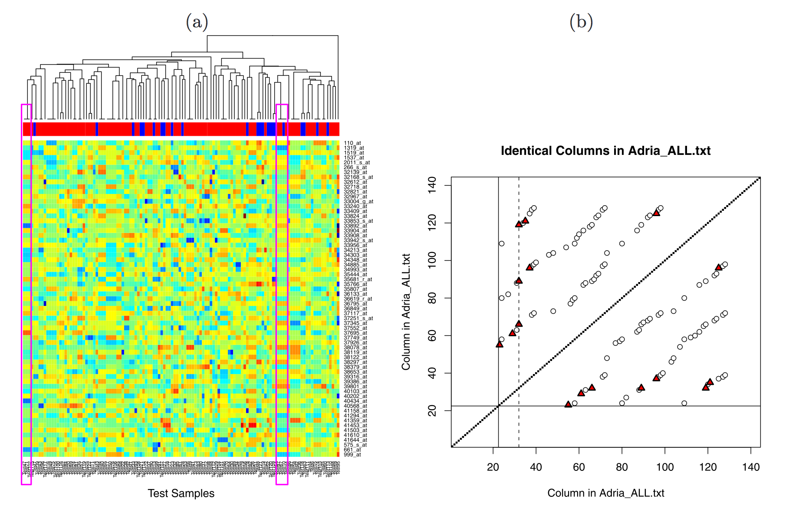
Baggerly & Coombes, AOAS 2009

Slide 9
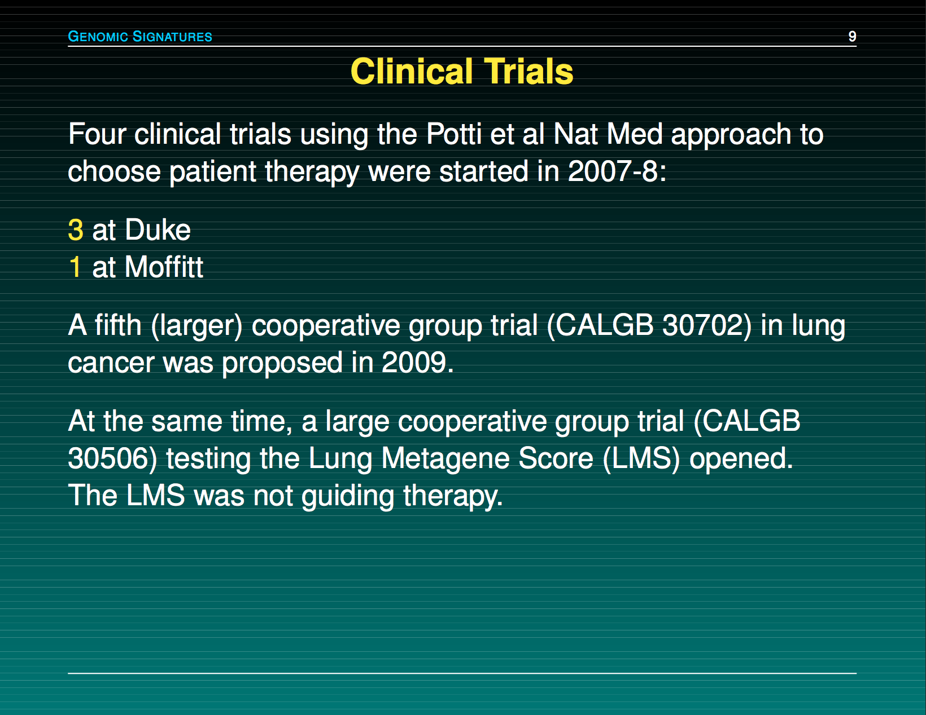

Slide 10
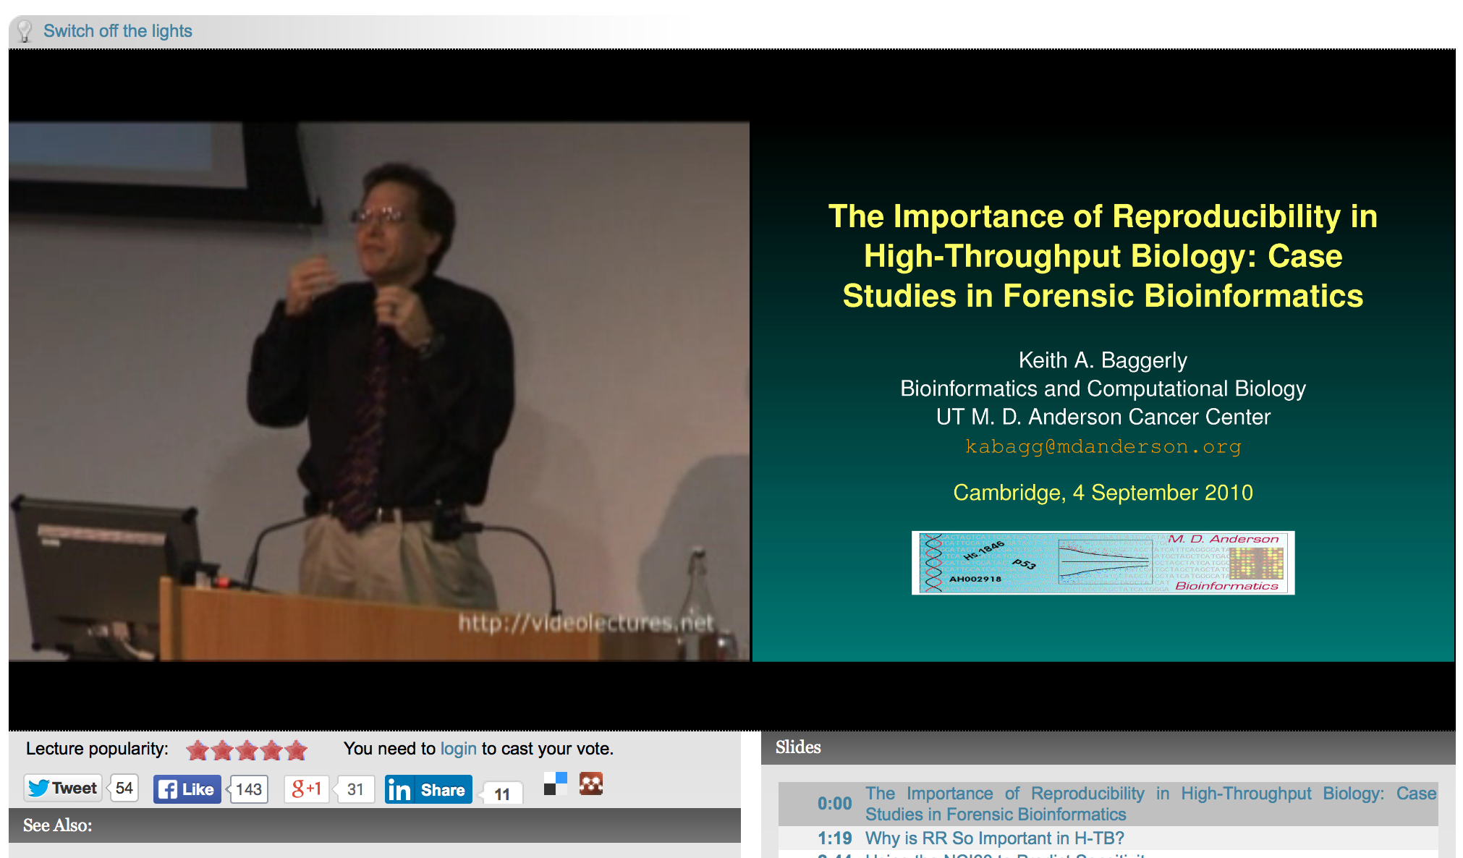
http://videolectures.net/cancerbioinformatics2010_baggerly_irrh/

Slide 11
Reproducibility
0
It’s the right thing to do!
The world would be a better place if everyone did it!
It’s the foundation of Science!
It’s the honourable thing to do!

Slide 12
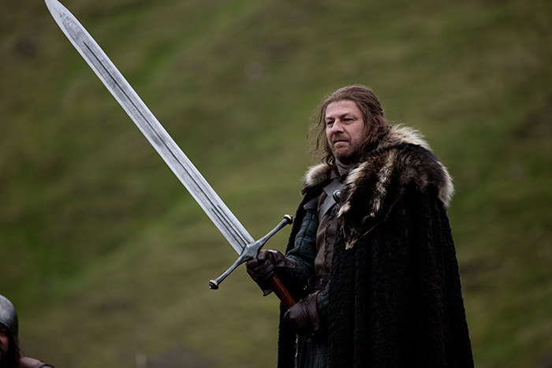

Slide 13


Slide 14
Reproducibility helps to avoid disaster
1

Slide 15
Anatomy of the NFκB pathway
Step 1
?
Hits
Weak
Phenotype
Strong
NFκB
Step 2
Knock-down
Compare
expression
phenotypes
by NEMs
Known pathway
members
New RNAi Hits

Slide 16
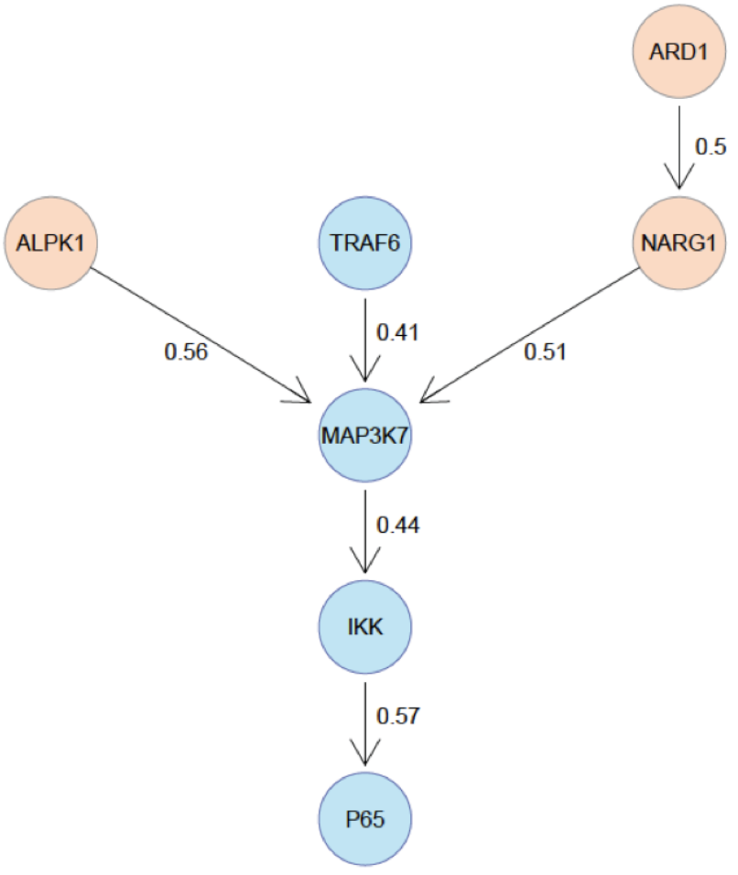
What a nice result!

Slide 17
A project is more
than a beautiful result!

Slide 18
Reproducibility is engaging
2

Slide 19
Example: grade

Slide 20
Reproducibility
starts early!

Slide 21
Reproducibility enables continuity
3

Slide 22
“I am so busy,
I can’t remember all the details of all my projects”

Slide 23
“I did this analysis 6 months ago.
Of course I can’t remember all the details any more …”

Slide 24
“My PI said I should continue the project of a previous postdoc.
But that postdoc is long gone and hasn’t safed any scripts or data.”

Slide 25
Reproducibility helps arguing with reviewers
4

Slide 26
PLoS Medicine example

Slide 27
Reproducibility increases your standing in the community
5

Slide 29


Slide 30
“Mind your own business!
I document my data the way I want!”

Slide 31
“Excel works just fine.
I don’t need any fancy R or Python or whatever.”

Slide 32
“I’d rather do
real science
than tidy up
my data”

Slide 33
“My field is very competitive
and I can’t risk wasting time”
Notes:
Think of it as putting in the right experimental controls. Can be time consuming but integral part of project.

Slide 34
“It’s only the result that matters!”

Slide 35
When do you need to worry about reproducibility?
Before you start the project
While you do the analysis
When you write the paper
When you co-author a paper
When you review a paper
ALWAYS!

Slide 36
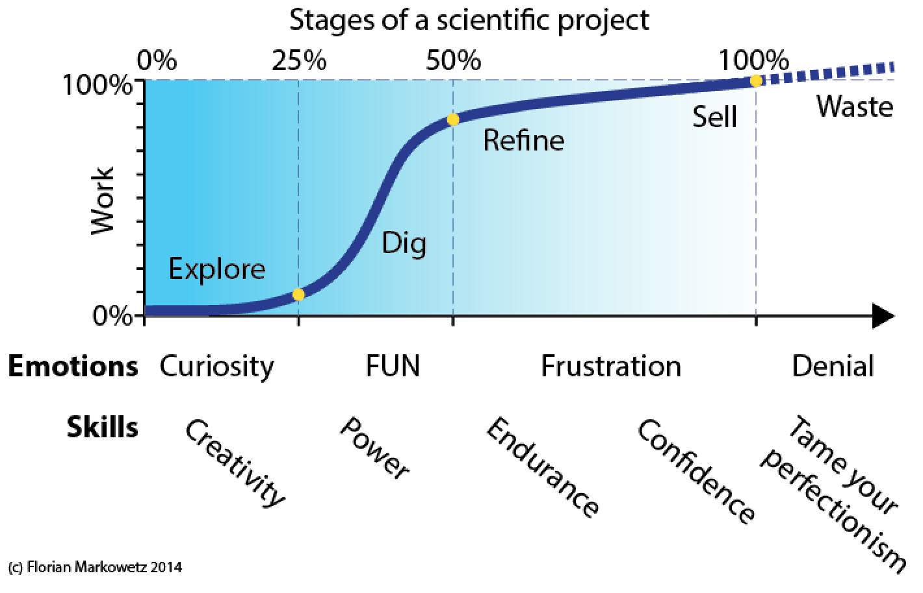
https://scientificbsides.wordpress.com/2014/05/26/methods-vs-insights-4-the-four-stages-of-a-project-and-the-fifth-you-should-avoid/

Slide 37
5 selfish reasons to work reproducibly
Avoid disaster
Makes it easier to engage
Continuity in the lab
Easier to argue with reviewers
Standing in the community

Slide 38
Scientific SOFT SKILLS
\project
\data
\code
\analysis
\paper
Organization of project
Tidy data
Tidy code
Control over tools
Documentation
Reproducibility
Less clicking and pasting,
more scripting and coding

Slide 39
Reproducibility is important for
Phd students
Postdocs
PIs
Learn tools and apply in daily work!
Create a ‘culture of reproducibility’ in your lab!

Slide 40
The next two talks
Gordon Brown
Stephen Eglen

Slide 41
Reproducibility rulez!
Thank you !

